Slide 1


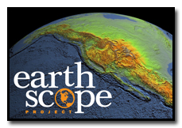
Reaching Diverse Audiences In Earth Scope's Education Outreach by Romina Fahl
Mentor: Dr. Wendy L. Taylor
University of Arizona Statewide Symposium
April 21, 2012

Slide 2
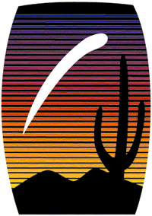
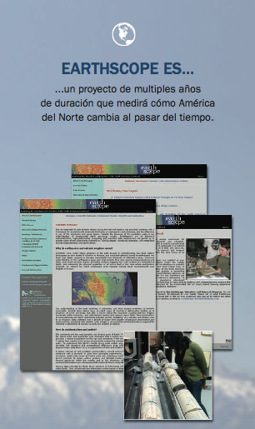
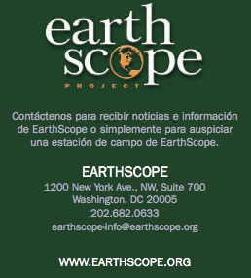
English to Spanish Translations
I am aiding EarthScope in reaching a wider audience by making brochures, cards, and informational materials available in Spanish.
Coming from a Spanish speaking household, I believe making these materials available in a language very common in Arizona households will greatly increase the public’s interest and general knowledge of EarthScope.

Slide 3
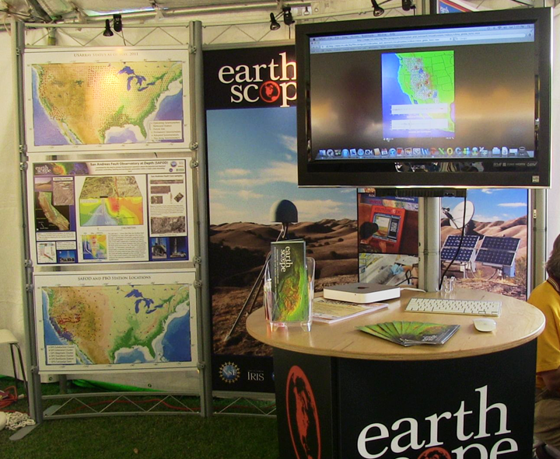
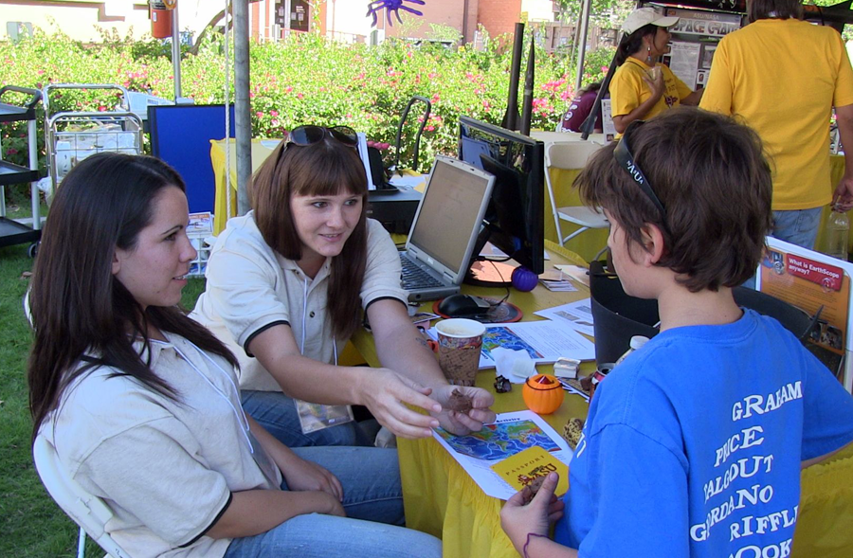
ASU Homecoming Block Party
Interacting with current ASU students as well as families.
Piquing children’s natural affinity for the sciences.
Leah Pettis, a fellow Space Grant intern, and I explaining the different ways earthquakes occur with the aid of a Milky Way bar.

Slide 4
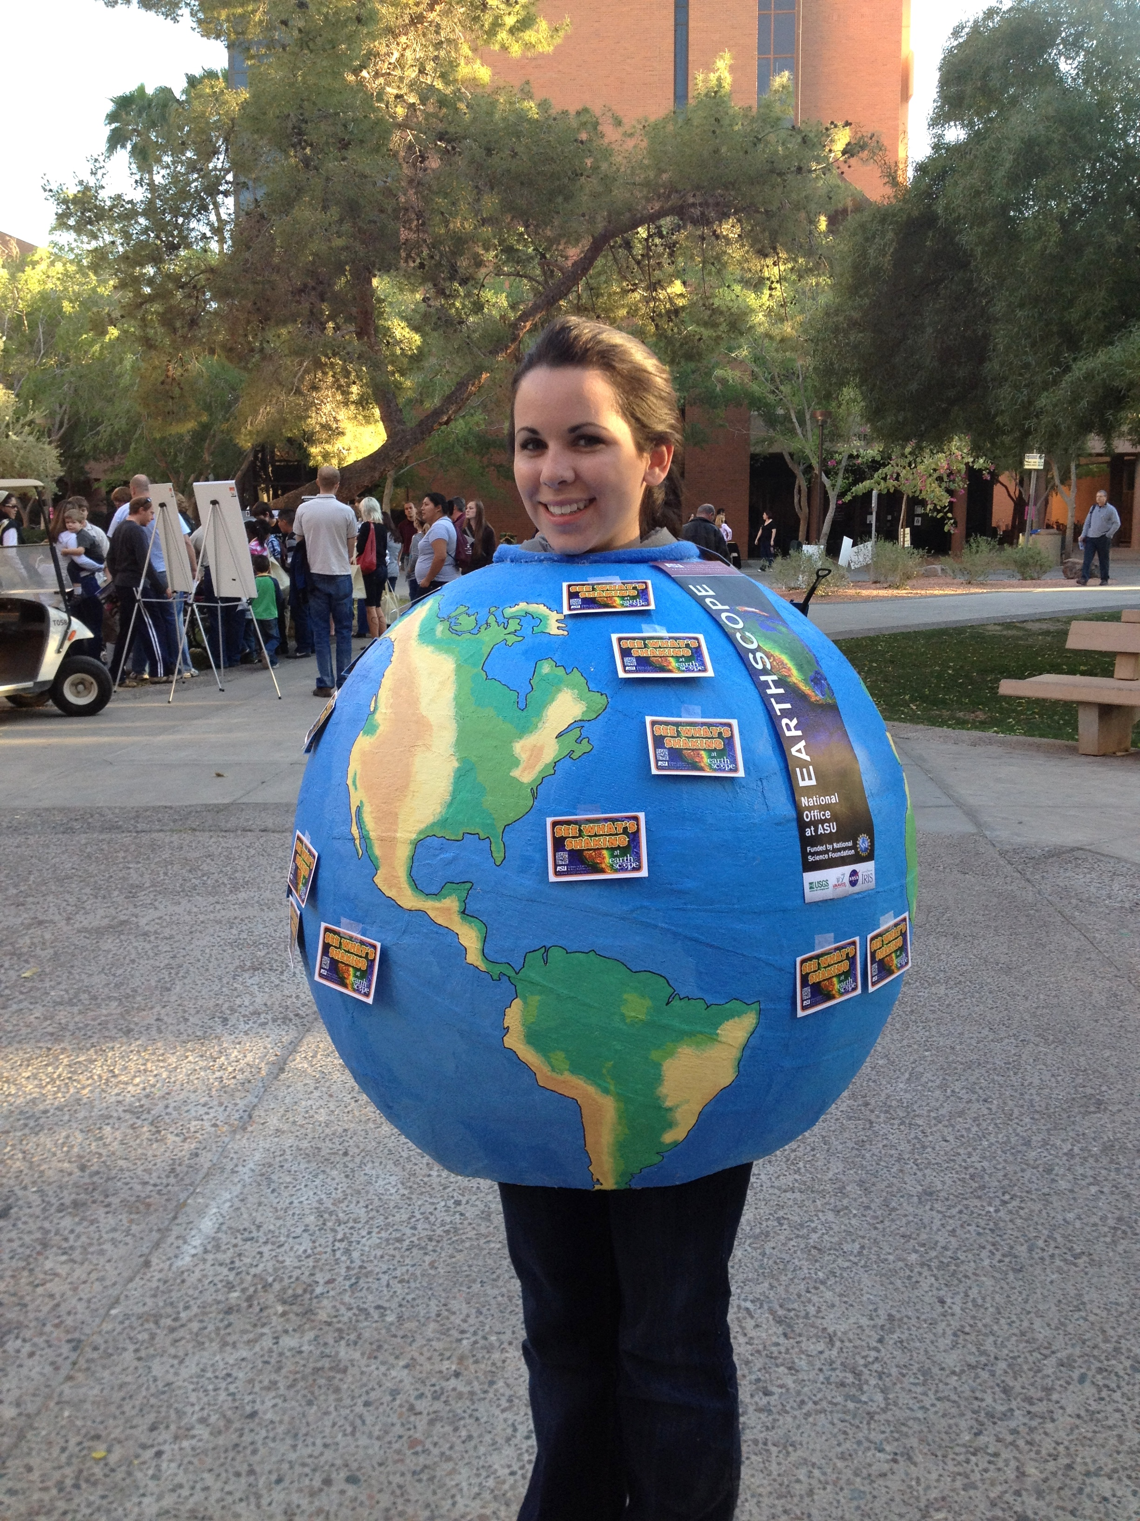
Earth Man
I designed and built this Earth Man/Woman costume for EarthScope.
It is a fun costume that is designed to catch people’s attention, and it was made to fit many different body types as well!

Slide 5
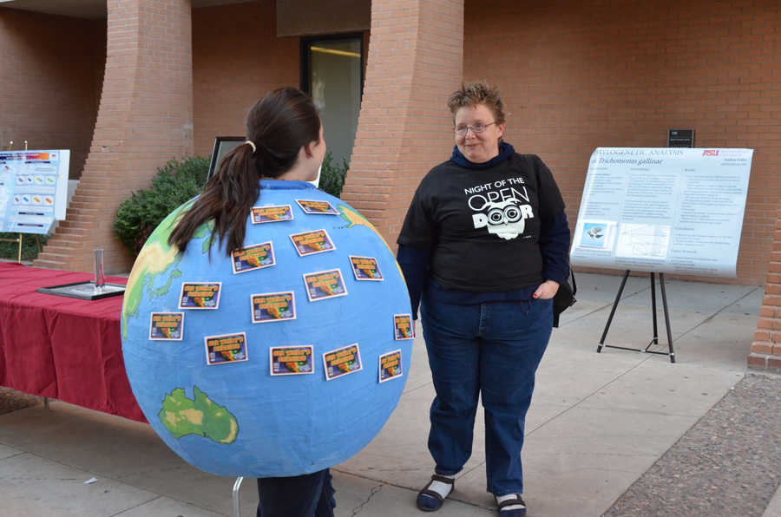
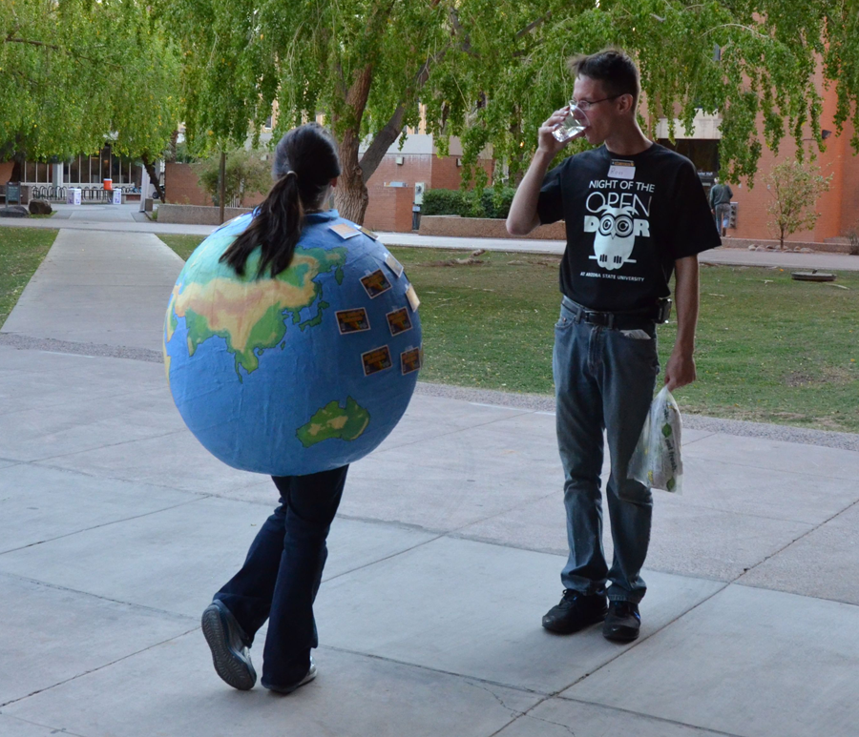
It garnered a lot of attention during its’ debut, which allowed me to direct people to learn more at the EarthScope booth!
Night of the Open Door

Slide 6
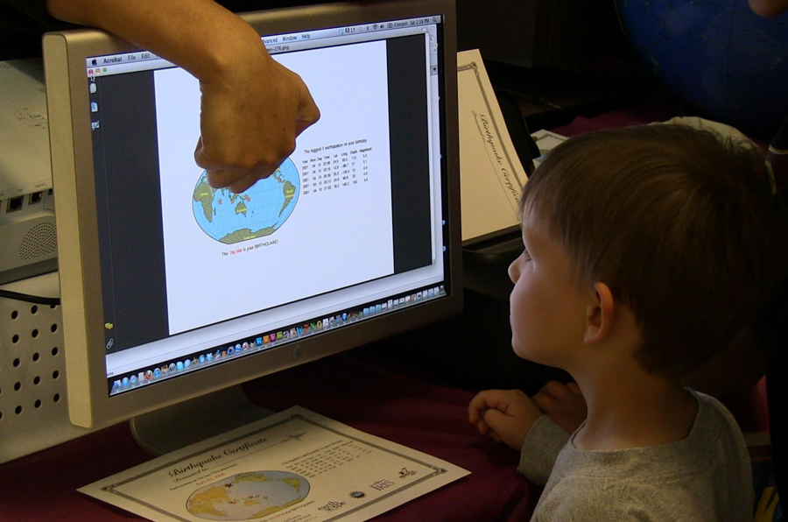
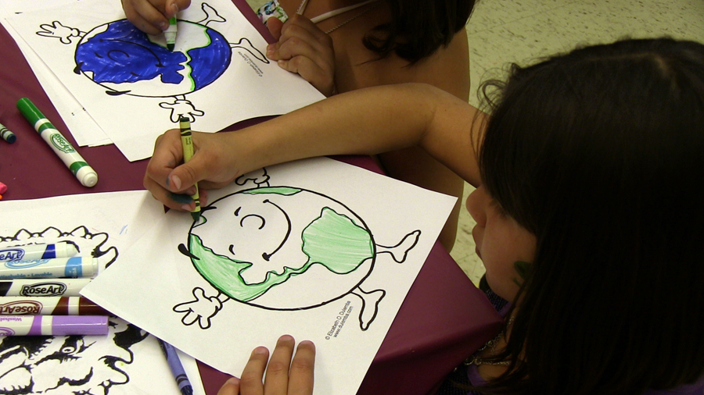
Earth and Space Exploration Day
A young boy is fascinated as he finds out about the major earthquakes that happened on his birthday, thanks to our BirthQuake program!
Two little girls draw as I compare the different layers of the Earth to the different layers in a Tootsie Pop!

Slide 7
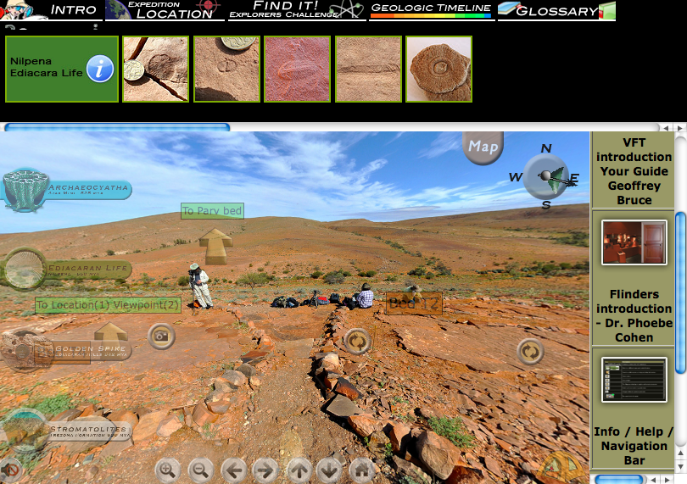
Astrobiology Virtual Field Trip
VFT is a project I am helping my mentor with, featuring online interactive websites where visitors can explore sites around the world.
This is the VFT on Ediacaran biota of the Flinders Ranges, South Australia
Notes:
Astrobiology Virtual Field Trip project featuring online interactive websites where visitors can explore sites around the world. This is the VFT on Ediacaran biota of the Flinders Ranges, South Australia.

Slide 8
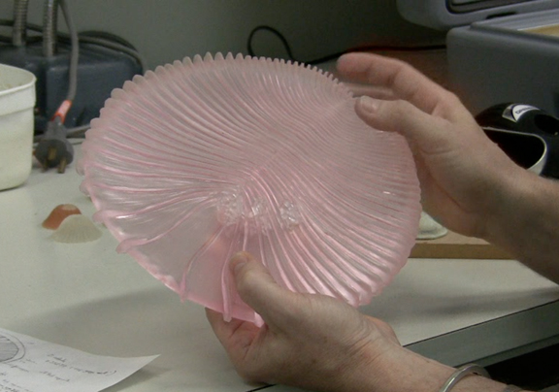
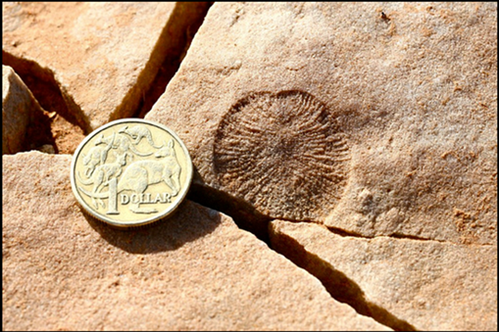
Bizarre Animals of the Ediacara: Experience Box
Classroom kit with casts of sixteen different fossils found in the field to be used with the VFT
Reconstruction of Dickinsonia costata to be made for the kit.
Fossil of Dickinsonia costata from the VFT website..

Slide 9
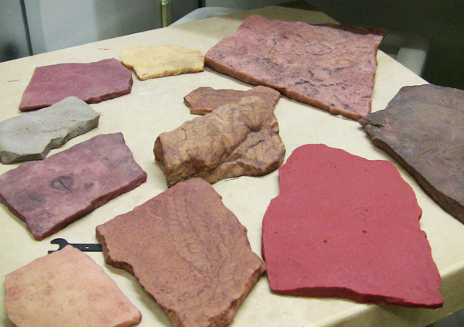
The Classroom Kits
Dr. Taylor and I are in charge of the lesson plans and activities that are to be used in conjunction with the Bizarre Animals of the Ediacara Experience Box.
These activities are aimed at giving students in grades 6-12 a hands-on learning experience with actual fossil casts.
Casts of Ediacaran fossils were made by the South Australia Museum, in Adelaide, South Australia.

Slide 10
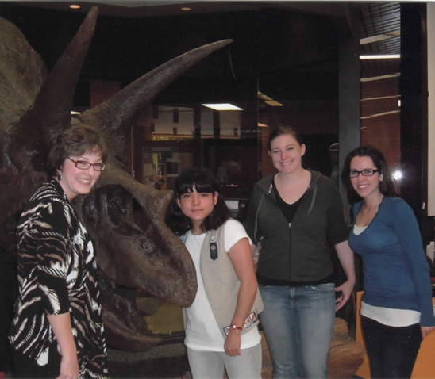
Project Summary
My Internship involved the following components:
Translation of EarthScope education materials into Spanish
Construction of an “Earth Person” costume for public outreach
Participation in outreach events at ASU
Creation of Astrobiology Virtual Field Trip “Experience Boxes”
Dr. Taylor, local student, Devon Baumback with me in the Dietz Museum.

